Slide 1
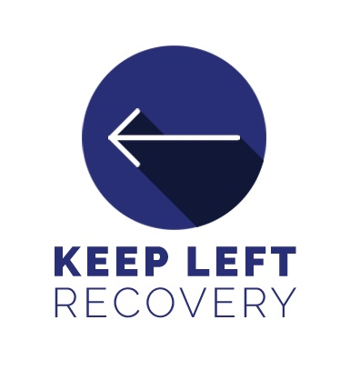
Choice Theory
AT A GLANCE: Satisfying Our Needs

Slide 2
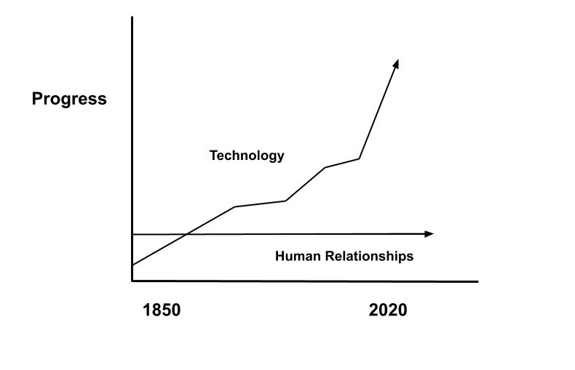
Progress of Human Relationships

Slide 3
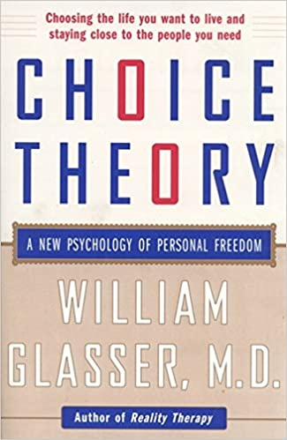
What Is Choice Theory?
A form of Cognitive-Behavioral Treatment (CBT)
Thoughts → Feelings → Actions
Explains the underlying mechanics of
human behavior and motivation
how personal meaning and identity are formed and sustained.
Motivation is always internally-originated, goal-directed, and adaptive.
All of our behaviors are always our best attempt - in the moment- to satisfy one or more of our Five Basic Needs

Slide 4
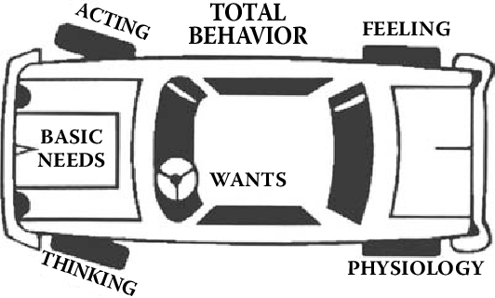
But First. A Few Key Points.
All we do from birth to death is behave.
There are no positive or negative behaviors. There is only more effective and less effective.
The Problem Relationship is always present in our lives.
The only person’s behavior I can control is my own.

Slide 5
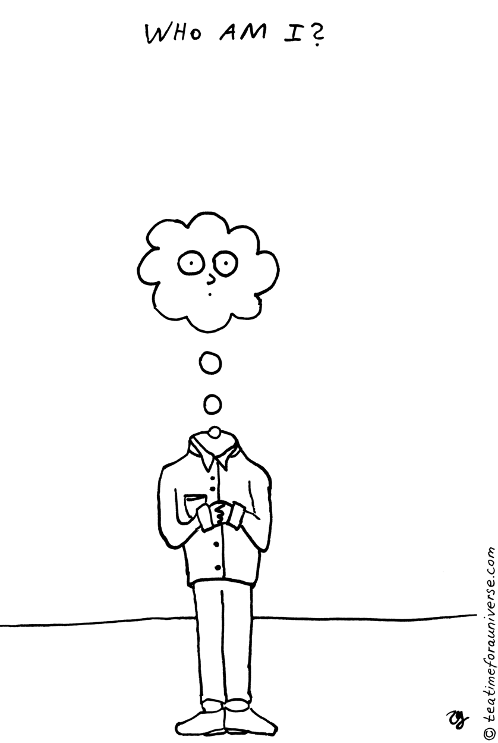
Survival (Safety & Identity)
A need encompassing everything you need to sustain life
health, shelter, nourishment
Reproductive sex to include survival of the species.
Tinder, One Night Stands, Boredom
Feeling safe and secure.
When Survival is met → Immediate Safety → Who am I? (Identity)

Slide 6
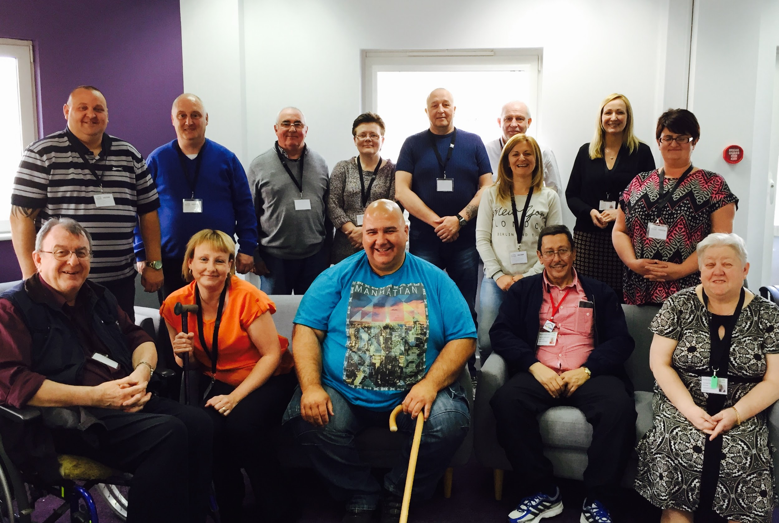
2. Love & Belonging
The drive to be connected with others
Friends, Family, Intimate partners
Co-Workers, Pets, and the groups you affiliate with.
Hardest Need to satisfy
#1 reason why people seek counseling
Only need that requires
Authentic other
Give in order to receive

Slide 7
3. Power (Significance)
This need involves the desire to
matter, make a difference, achieve
be competent, recognized, respected
It includes self-esteem and a desire to leave a legacy.
Often misunderstood as Power Over (someone, something, a group, etc.)
Choice Theory teaches how to find Power or Significance from within.

Slide 8
4. Freedom
The need for freedom is about
Having choices
Being independent and autonomous
Being able to move freely without restriction
Being Creative.

Slide 9
5. Fun
This need encompasses
Pleasure
Play
Humor
Relaxation
Learning
The most forgotten need, especially in Men.

Slide 10
So Why Does all this matter?
Satisfying these 5 genetic needs is the source of our motivation & attempt to find meaning
For someone suffering from a Substance Use Disorder → addiction (in the short term) satisfies all 5 basic needs.
According to Choice Theory, People seek counseling due to being dissatisfied with a present relationship.
This includes friends, family, bosses, organizations, co-workers, and most importantly ourselves.

Slide 11
7 Open Roads for Relationships
7 Dead End Roads for Relationships
Supporting
Encouraging
Listening
Accepting
Trusting
Respecting
Negotiating Differences
Criticizing
Blaming
Complaining
Nagging
Threatening
Punishing
Bribing, Rewarding to Control

